Slide 1
Netflix - Data Exploration and Visualization
Group 21
Sriram Jagadeesan
Manish Yadav

Slide 2
What
Analyze the content released by Netflix and gain some insights into how the OTT platform is using the viewers content consumption (over a period) and changing business strategies of the company based on it.
WHY
To showcase different insightful visualizations with user friendly and easy navigation to understand the impact of Netflix platform and how they are gaining by learning the viewers choice and view history.
How
Using the D3.js package, Echarts and CSS we will be creating an interactive dashboard using Line, Geospatial, and other charts.

Slide 3
Project steps:
Download and load the dataset
Choosing an appropriate color palette.
Import and install required libraries
Data preparation and cleaning
Forming basic graph outlines for geospatial, bar graph and line graph.

Slide 4

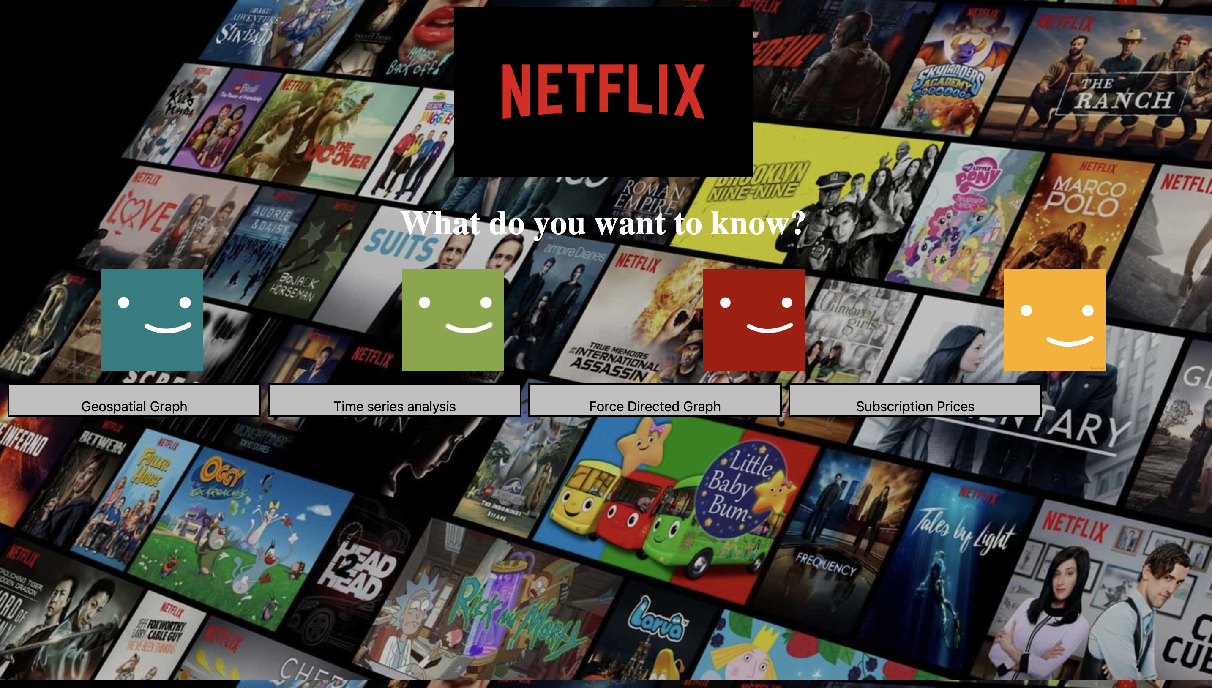
Main dashboard
We have created the main dashboard with Four graph options and added clickable options to it for easy navigation.

Slide 5

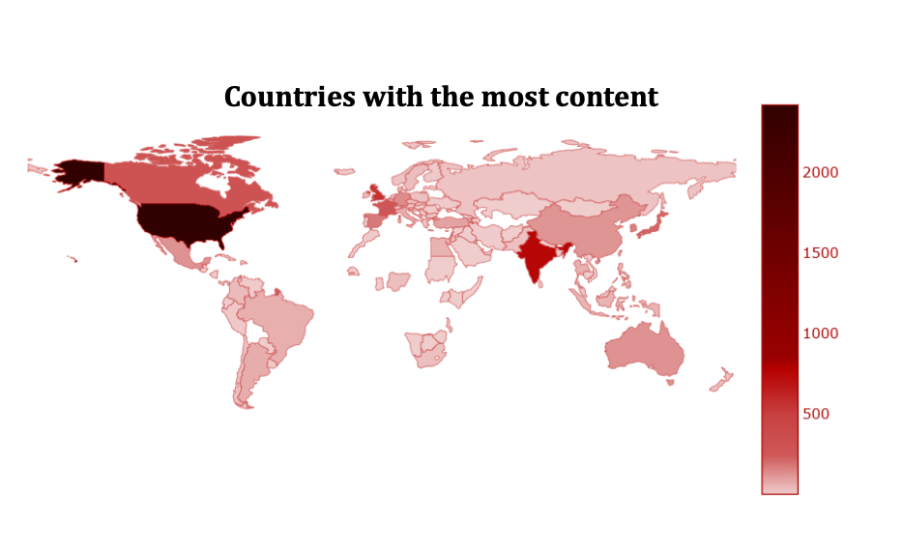
Geospatial Impact
The projected outcome for the geographical graph is to show which countries have what kind (Movies/TV shows) of content and how much of it they consume. As of now we have just created the geospatial and added the color palette. To make it more interactive and informative, filters will be added.

Slide 6
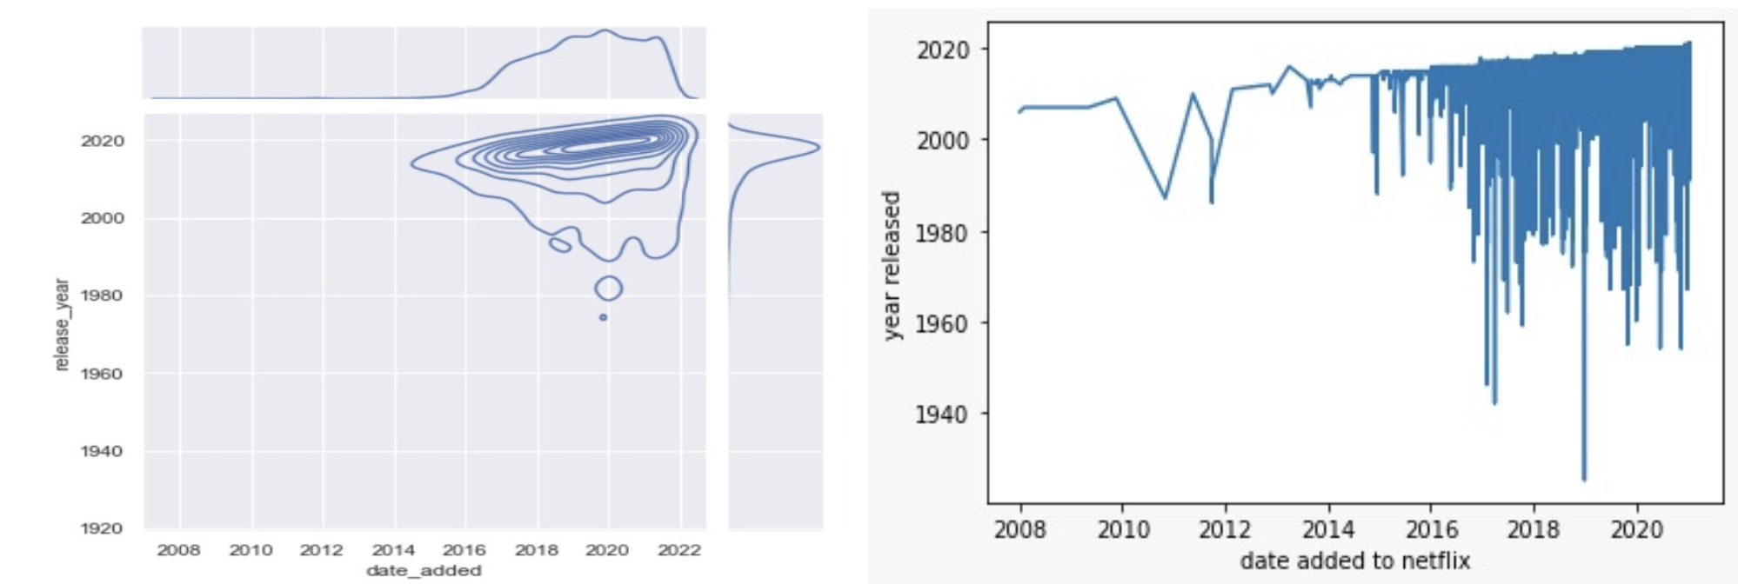
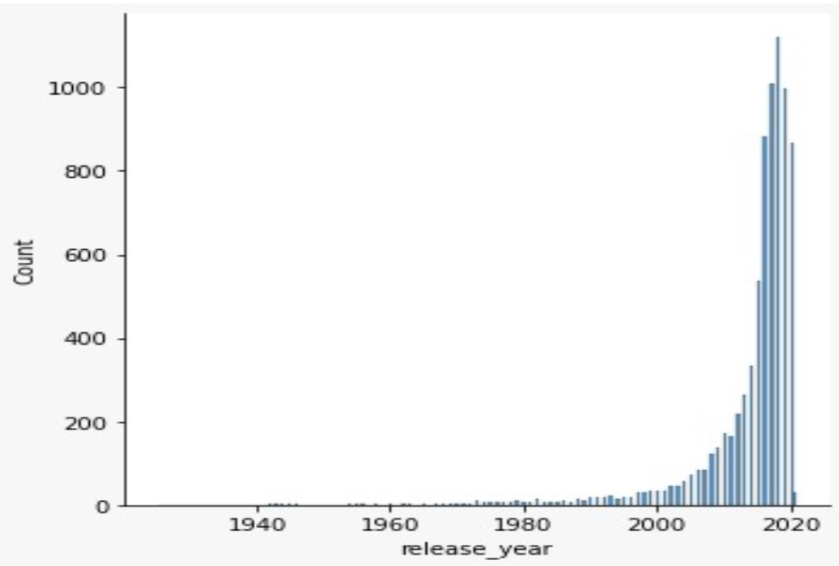
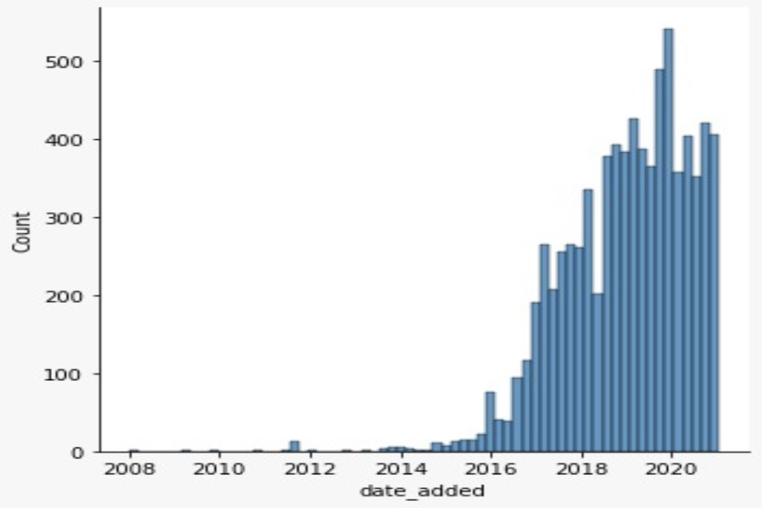
Time Series Analysis
Fig 1 &2 : The visualization depicts the trend at which content added to netflix has been diversified based on year of release.
Fig 3: Depicts the year of release of the content that has been added to netflix over the years.
FIG 4: Visualization depicts the trend at which content added to netflix has been diversified based on year of release.

Slide 7
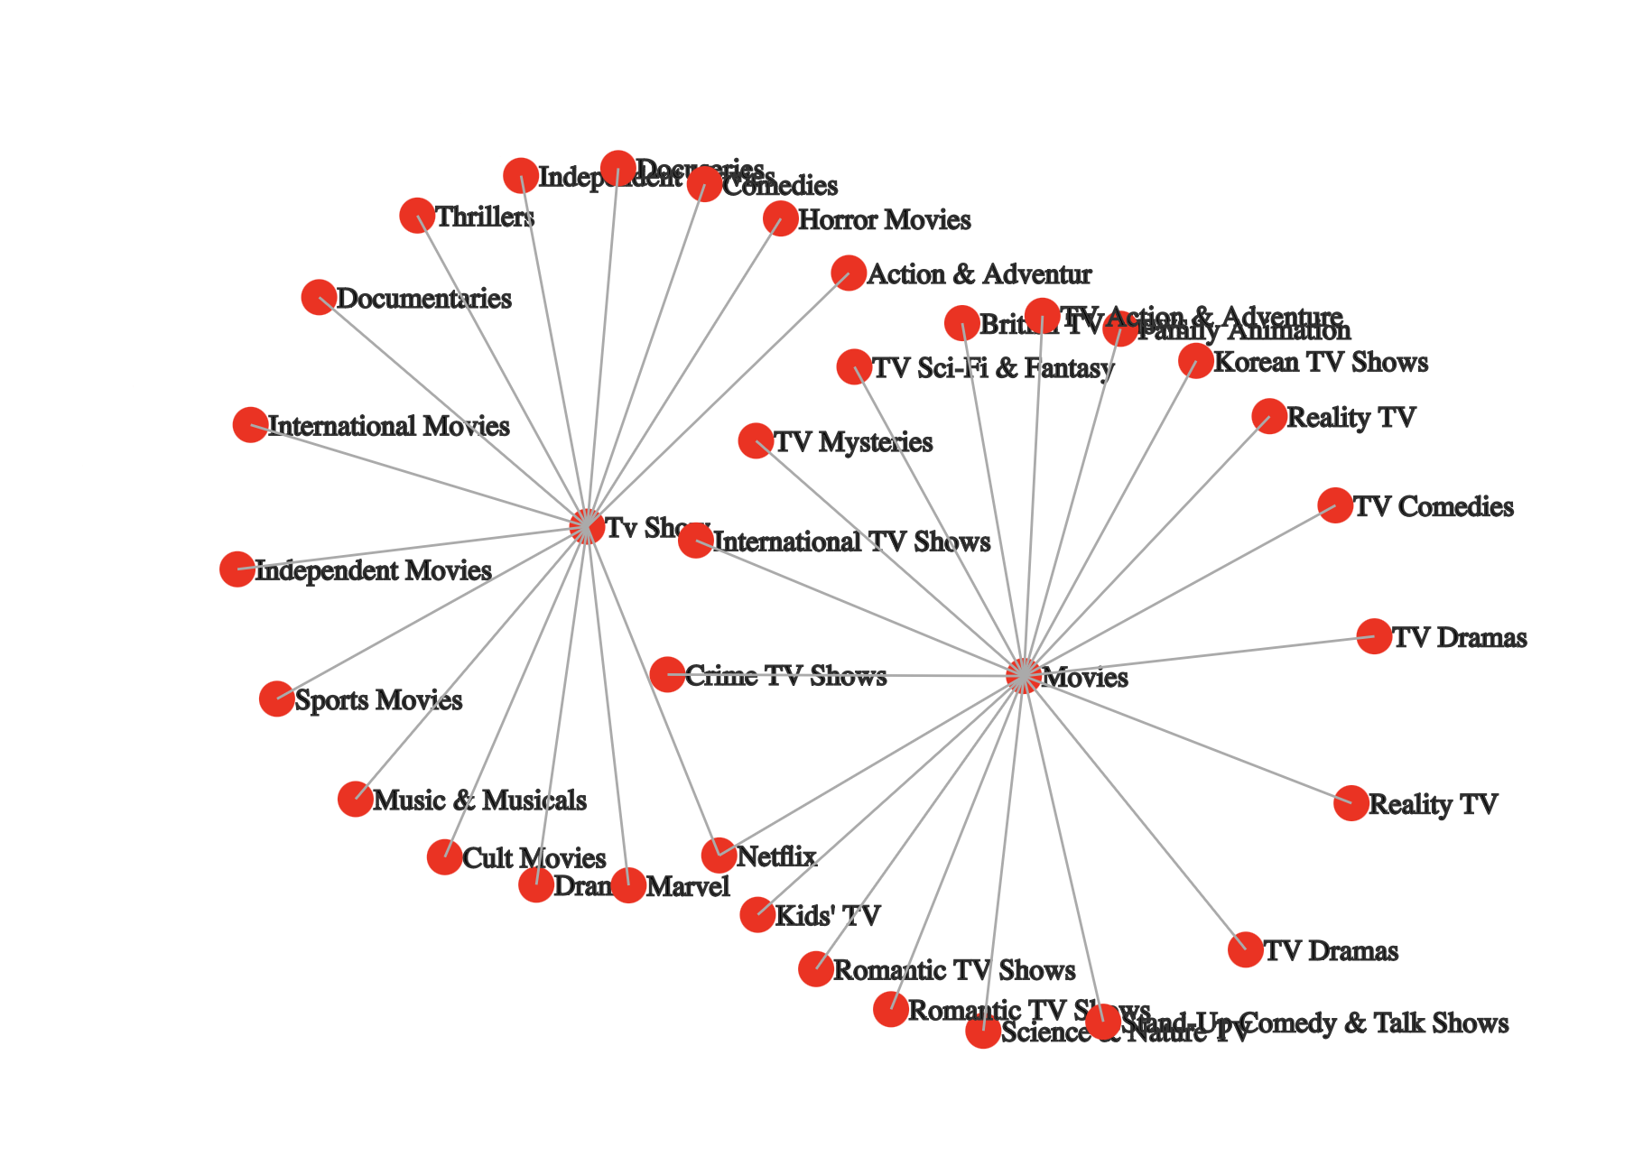
Force Directed Graph
It is used to visualize the connections between objects in a network.
The graph shows a set of Genre as nodes, with links between a pair of genres indicating that audience who liked onE OF them are likely to enjoy the other.

Slide 8
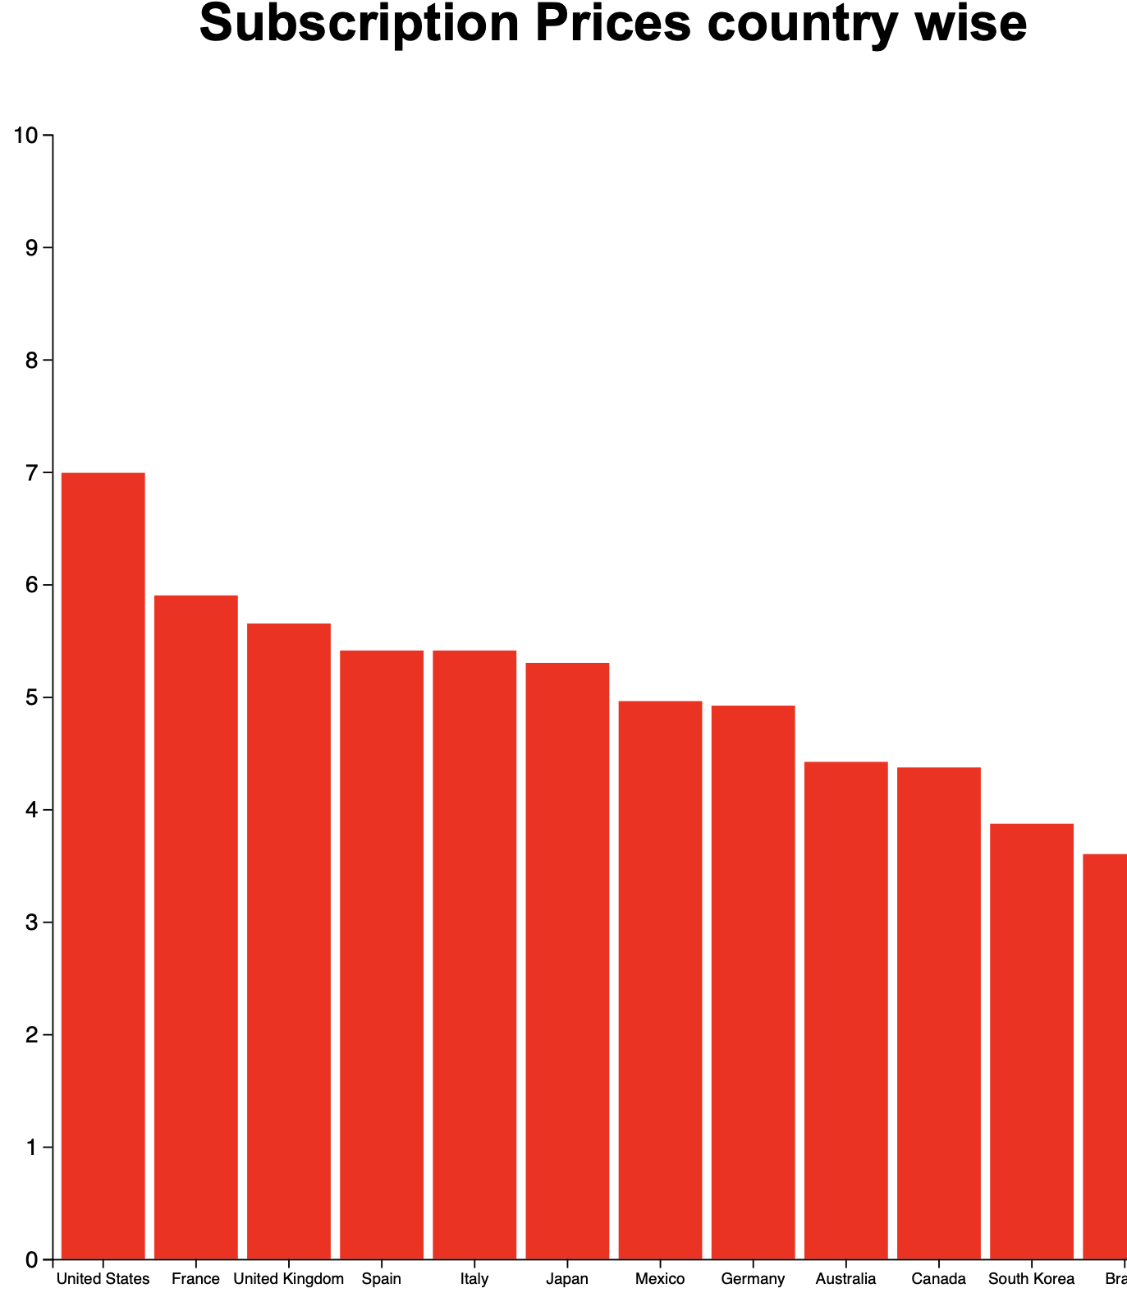
Bar Graph for Price details
This graph helps in showcasing the Subcription Rates in Major countries.We can see that it’s the Highest for USA where even the content production is more compared to other regions.

Slide 9
Conclusion and future work:
Overall, the visualization was successful in conveying significant Netflix information through the use of a story. The dashboards made that quite clear.
We can infer from all the Graphs that USA is leading country in terms of content creation, subscription costs, number of subscribers and so on.
We could add more information in the future, such as IMB ratings and data on how many people share a single subscription.

Slide 10
Data source links
https://www.kaggle.com/niharika41298/netflix-visualizations-recommendation-eda
https://www.kaggle.com/datasets/shivamb/netflix-shows
https://www.comparitech.com/blog/vpn-privacy/countries-netflix-cost/

